Slide 1

CAPSTONE PROJECT PRESENTATION
CSA4308-Internet Programming
E-Commerce Shopping Website
Guided By:
Dr. K Rajagopal
Presented By:
B Manish_192411149
Ch Jignesh_192411154
K Eswar_192411176
P Furkhan_192311341
V Aswini Pavan Kumar_192372151

Slide 2


Introduction
E-Commerce Shopping Website is an online platform that allows customers to browse, search, and purchase products.
It provides a convenient shopping experience from anywhere and at any time.
The system manages products, users, orders, and payments efficiently.
Administrators can monitor sales, inventory, and customer activities.
The website ensures secure transactions and user-friendly navigation.

Slide 3
Problem Statement
The E-Commerce Shopping Website provides a secure and user-friendly platform for online purchasing. Customers can browse products, add items to a cart, place orders, and make online payments conveniently. The system helps businesses manage products, inventory, and customer orders efficiently. It also includes an admin dashboard for monitoring sales and generating reports. This project improves shopping convenience, business operations, and overall customer satisfaction.

Slide 4
Motivation and Need for the Project
To provide customers with a convenient way to shop online anytime and from anywhere.
To reduce the time and effort required for purchasing products from physical stores.
To help businesses efficiently manage products, orders, payments, and customer information.
To improve customer satisfaction through secure transactions, easy navigation, and faster order processing.

Slide 5
Objectives
Develop a responsive online shopping platform.
Enable secure user registration and authentication.
Manage products and categories efficiently.
Provide seamless cart and checkout functionality.
Generate reports and analytics for business management.

Slide 6
Literature Review
S. No | Details of the Journal | Methodology Used | Advantages | Disadvantages
1 | Jansen et al. (2024) – Online Shopping Recommender Systems | Recommender System | Personalized suggestions | Needs user data
2 | Wu (2024) – E-Commerce Recommender Systems | Collaborative Filtering | Better product recommendations | Cold-start problem
3 | Bodduluri et al. (2024) – Hybrid Recommendation Systems | Hybrid Method | Improved personalization | Complex implementation
4 | Paraschakis & Nilsson (2024) – AI in E-Commerce | AI & Data Mining | Improves customer experience | Requires large data
5 | Kathriarachchi et al. (2024) – Risks of E-Commerce Recommender Systems | Risk Analysis | Identifies security risks | Privacy concerns

Slide 7
Existing System and Its Limitations
Existing e-commerce systems mainly provide basic product browsing, shopping cart, and online ordering features.
Some platforms have complex interfaces that may be difficult for new users to navigate.
Product recommendations are often limited or not personalized to individual customers.
Inventory and order updates may not always be available in real time.
Basic systems provide limited sales analysis and reporting features for administrators.

Slide 8
Proposed System and Novel Features
Develop a web-based E-Commerce Shopping Website that allows users to browse, search, and purchase products online.
Provide secure user registration, login, shopping cart, and online payment facilities.
Include a personalized product recommendation feature based on user preferences and purchase history.
Offer real-time inventory updates and order tracking for better user experience.
Provide an admin dashboard with sales analytics, inventory monitoring, and report generation for effective business management.

Slide 9
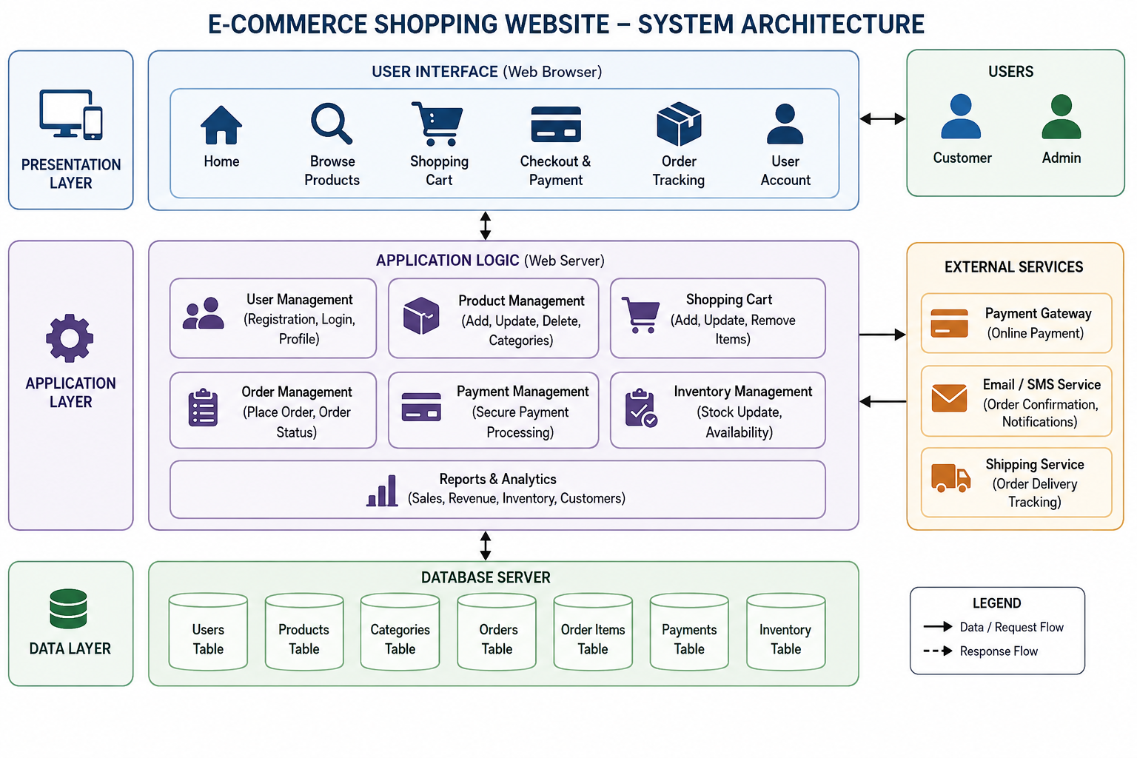
System Architecture

Slide 10
Module 1: User Management
New users can create an account.
Existing users can log in securely.
Users can update their profile information.
Users can change or reset their passwords.
The system stores user details safely.

Slide 11
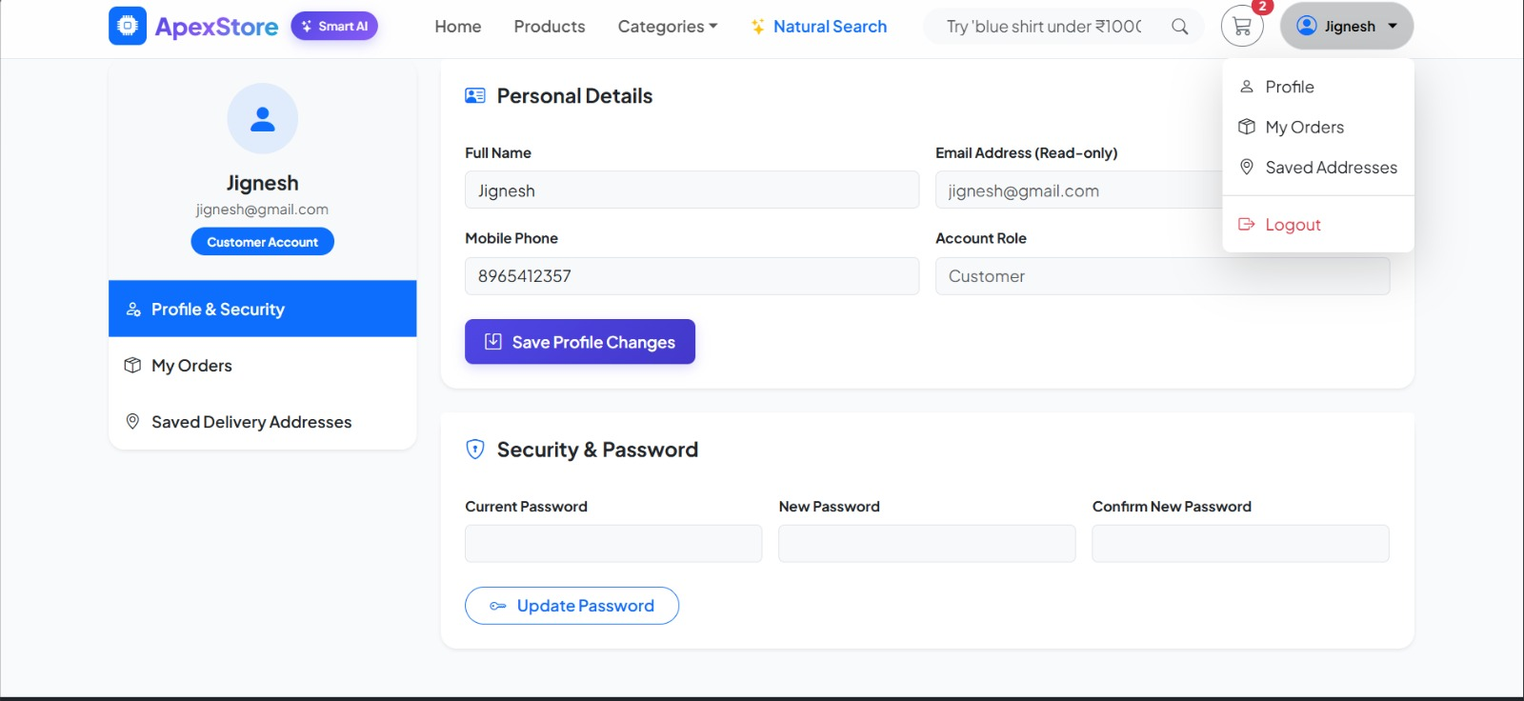
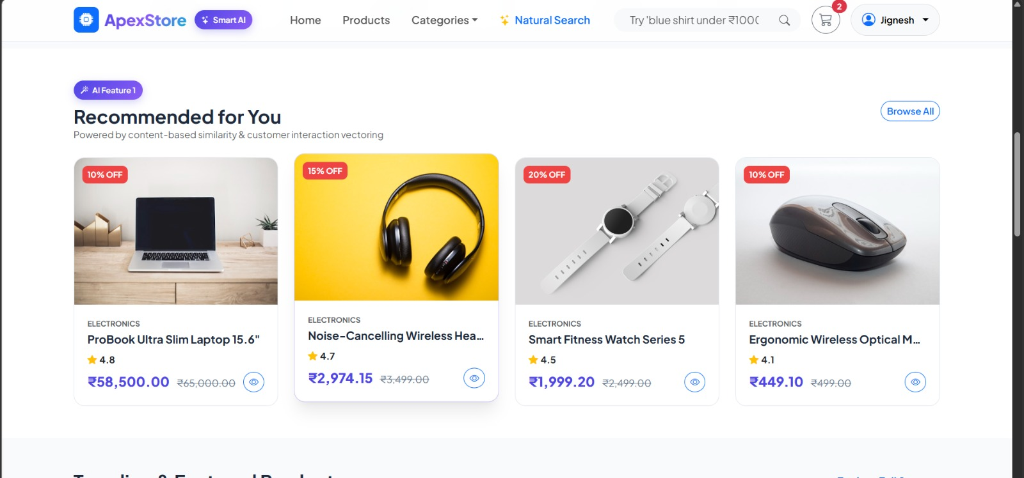

Slide 12
Module 2: Product Management
Admin can add new products to the website.
Admin can edit product details and prices.
Admin can remove unavailable products.
Products are organized into categories.
Stock availability is updated automatically.

Slide 13
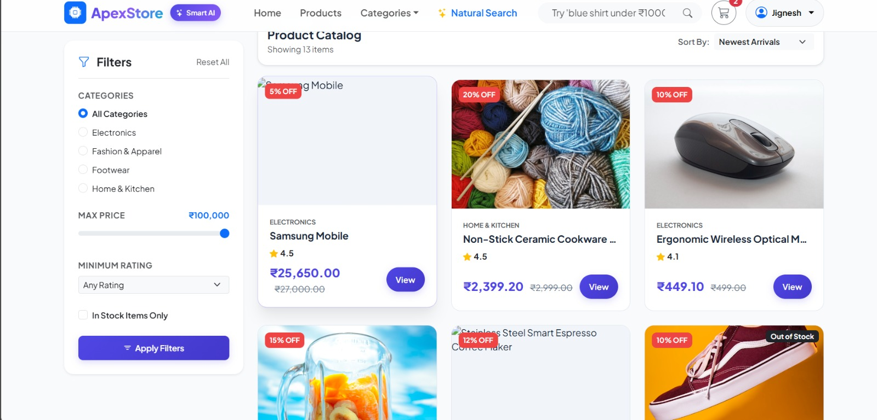

Slide 14
Module 3: Shopping Cart
Users can add products to their cart.
Users can change the quantity of items.
Users can remove products from the cart.
The cart shows the total amount to be paid.
Cart items are saved until checkout.

Slide 15
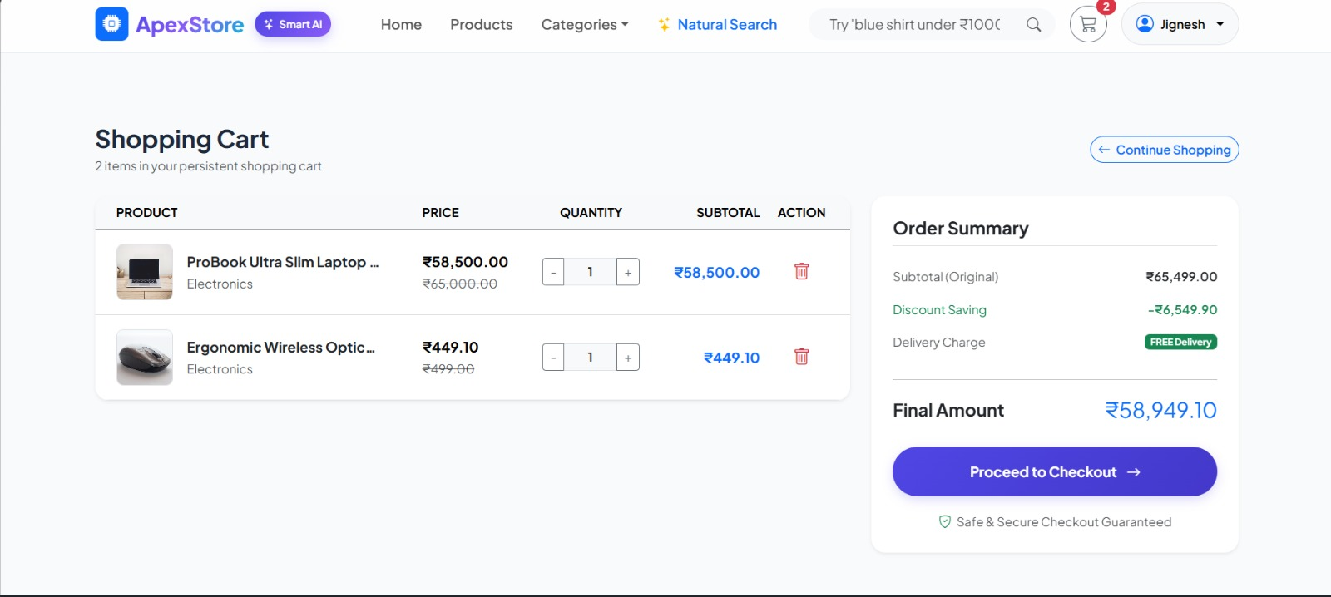

Slide 16
Module 4: Order & Payment Management
Users can place orders for selected products.
Users can make payments through online methods.
The system generates order confirmations.
Users can track their order status.
Order history is stored for future reference.

Slide 17
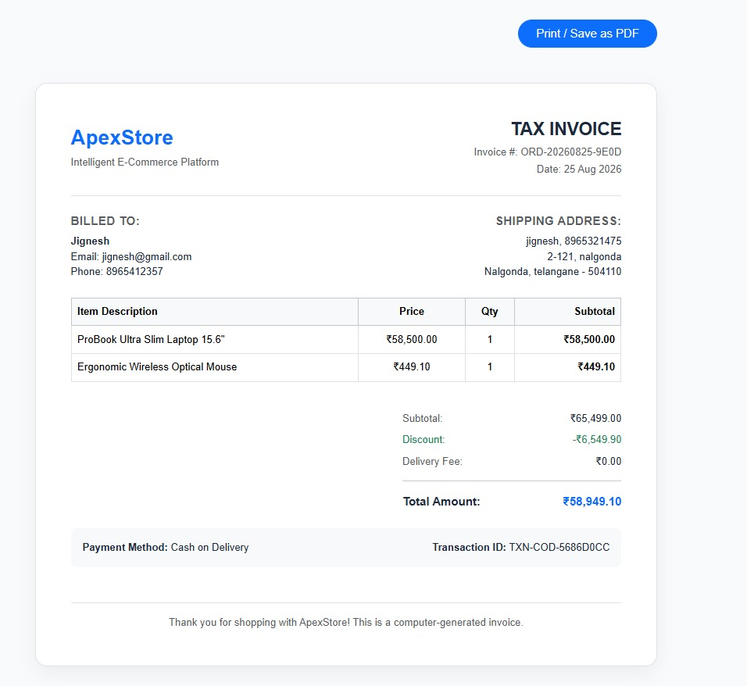
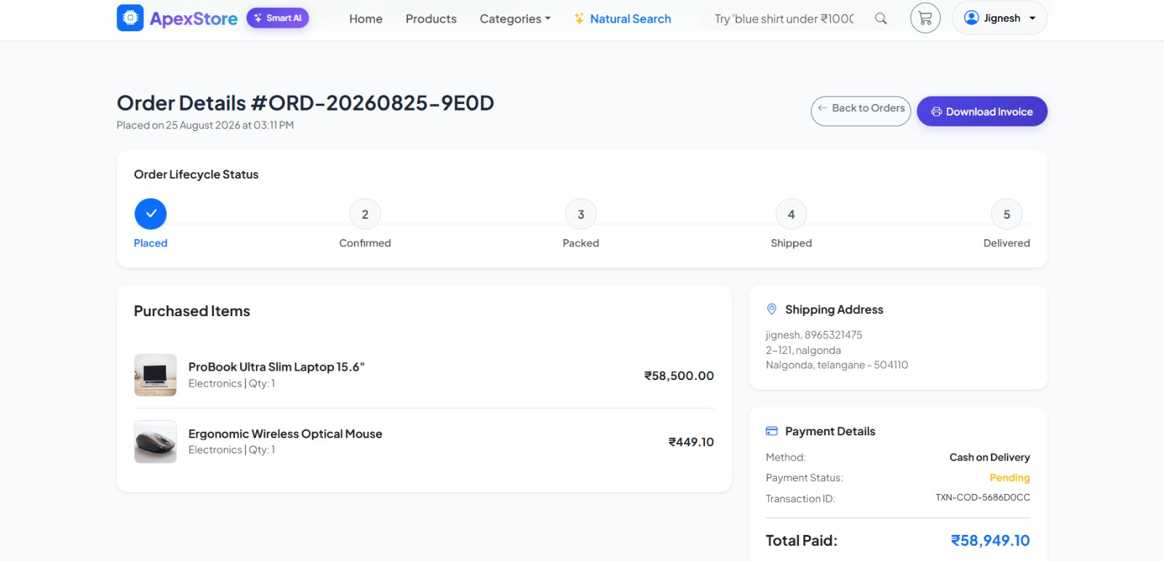

Slide 18
Module 5: Admin Dashboard & Reports
Admin can view all users and orders.
Admin can monitor product sales.
Admin can check inventory levels.
Sales reports are generated automatically.
Revenue and business performance can be analysed.

Slide 19
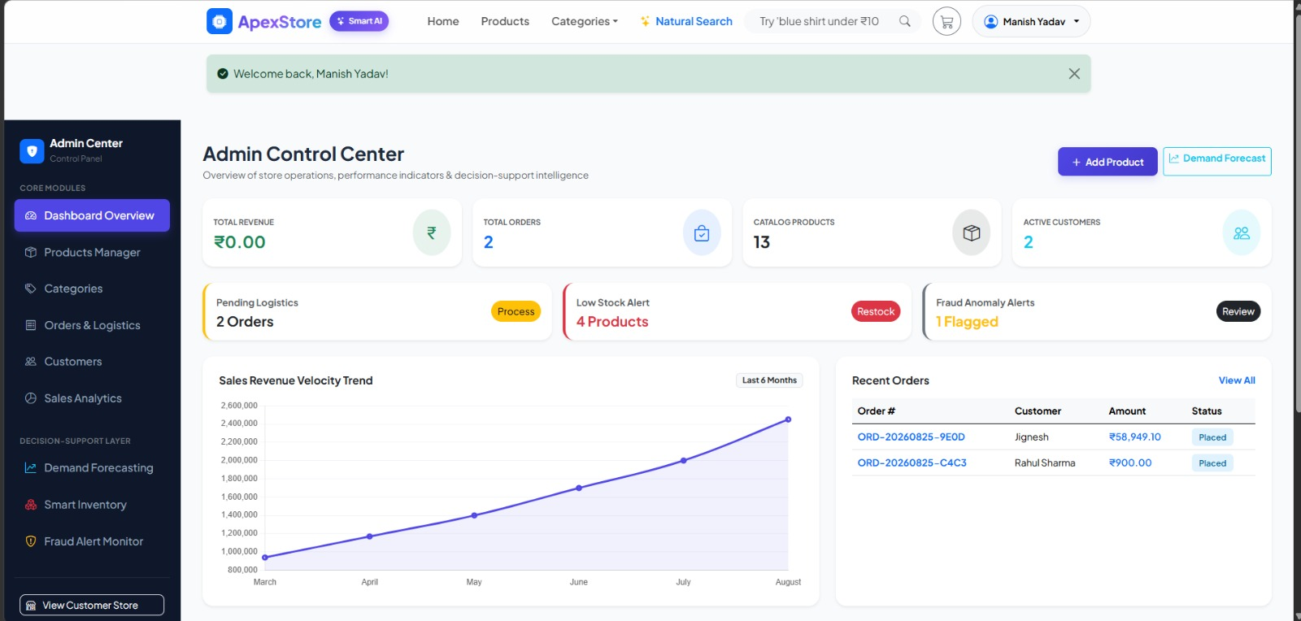

Slide 20
Technologies, Software, Hardware, and Tools
Frontend: HTML, CSS, JavaScript, and Bootstrap for designing the website.
Backend: PHP for handling user requests, orders, and business logic.
Database: MySQL for storing users, products, orders, payments, and inventory.
Software: Visual Studio Code, XAMPP, phpMyAdmin, and a web browser.
Tools: Git/GitHub for version control and Postman for API testing.
Hardware: Laptop/Desktop with at least 4 GB RAM, 10 GB storage, and an internet connection.

Slide 21
Results and Discussion
The system successfully provides a user-friendly platform for browsing and purchasing products online.
Users can register, log in, manage their cart, place orders, and complete payments.
Admins can efficiently manage products, users, orders, and inventory.
The dashboard provides useful sales, revenue, and inventory reports.
Overall, the proposed system improves shopping convenience, reduces manual work, and supports efficient e-commerce management.

Slide 22
Future Scope
Develop a mobile application for Android and iOS users.
Add AI-based product recommendations based on customer interests and purchase history.
Introduce voice search to make product searching easier.
Provide advanced sales analytics and real-time business insights.
Integrate more secure payment options and improve fraud detection.

Slide 23
Conclusion
The E-Commerce Shopping Website provides a complete online shopping solution.
It simplifies product management, order processing, and customer interactions.
The system enhances user experience and business efficiency.
It can be further expanded with advanced technologies and intelligent features.

Slide 24
Thank You

